Slide 1
BANK ANALYSIS P596
GROUP 2
Guttapalem eswar sai adarsh
Ujjawal Kumar
Aman Ajay Doshi
Mandala Harshitha Reddy
Nagarjun J K
Gouthula advika
Lingala Shashidhar

Slide 2
agenda
Problem statement
Primary objective
Insights
Dashboards using different tools
Solutions or suggestions

Slide 3
Problem Statement
Given the need for deeper insights into the loan portfolio's performance, particularly focusing on loan amount trends, risk exposure by credit grade, payment reliability based on verification, regional loan performance, and the impact of homeownership on payment behavior, the following key questions arise:
Loan Disbursement Trends
Risk Concentration
Verification Impact
Regional and Temporal Loan Performance
Homeownership and Payment Behavior

Slide 4
primary objective
The primary objective is to use these insights to refine risk management strategies, enhance payment reliability, optimize loan expenditure, and tailor customer engagement based on homeownership and regional factors.

Slide 5
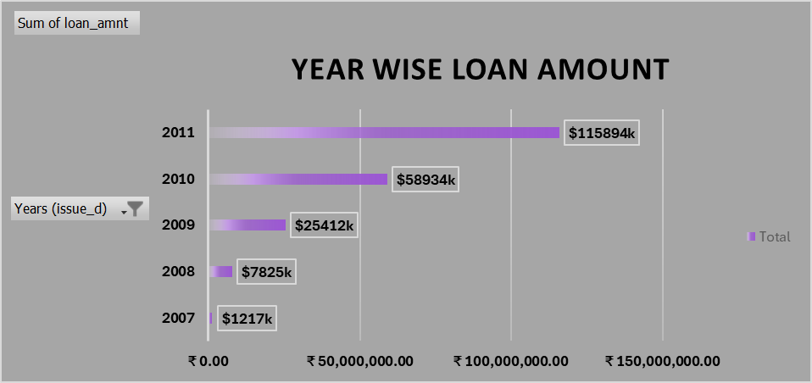
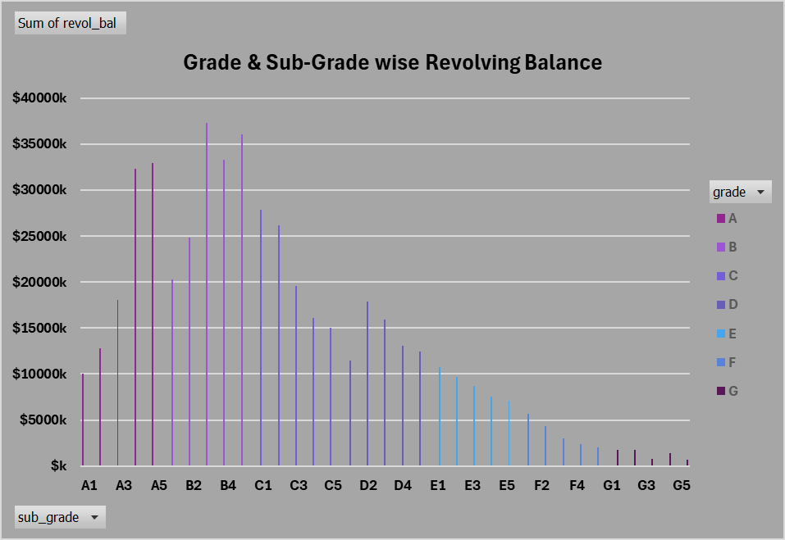
Insights
KPI 1:
There has been substantial growth in loan amounts over the years, particularly from 2009 to 2011.
KPI 2:
The middle-tier categories (B and C) hold the most significant revolving balances, indicating potential risk concentration in these categories.

Slide 6
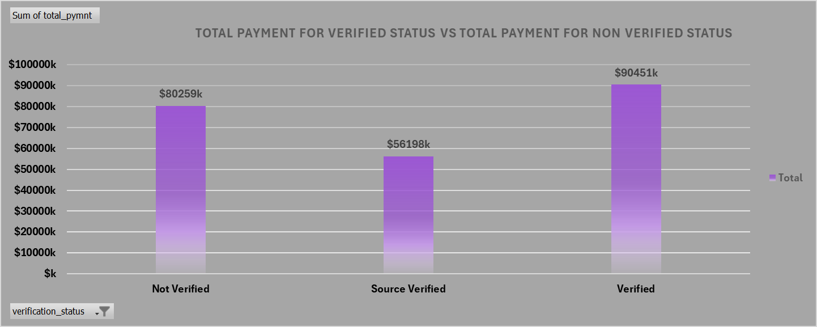
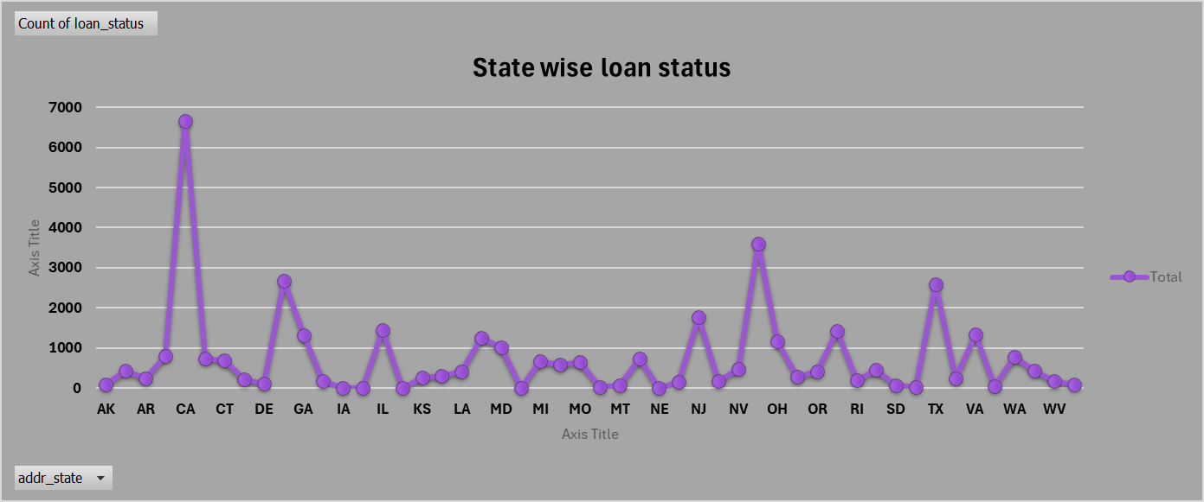
insights
KPI 3:
Verified payments contribute the most to the total payments, suggesting that verification processes may correlate with higher payment amounts.
KPI 4:
The states CA and OH got most of the loan amount as verified.

Slide 7
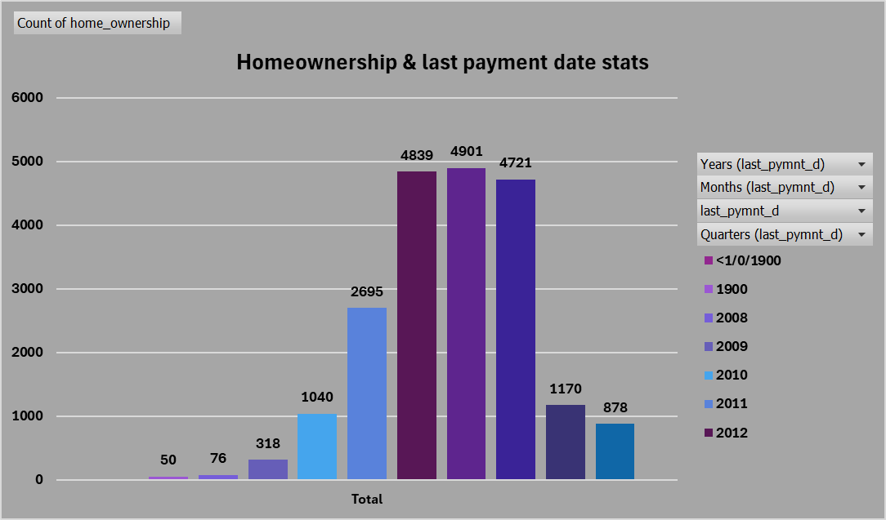
insights
KPI 5:
The count of home ownership has seen fluctuations, with a noticeable peak in the early 2010s.

Slide 8
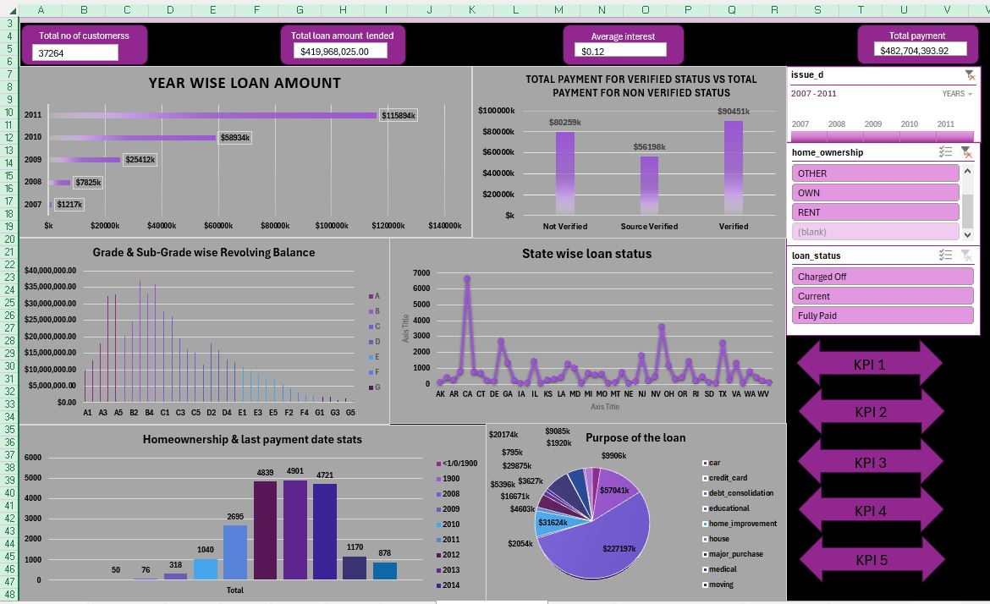
excel dashboard

Slide 9
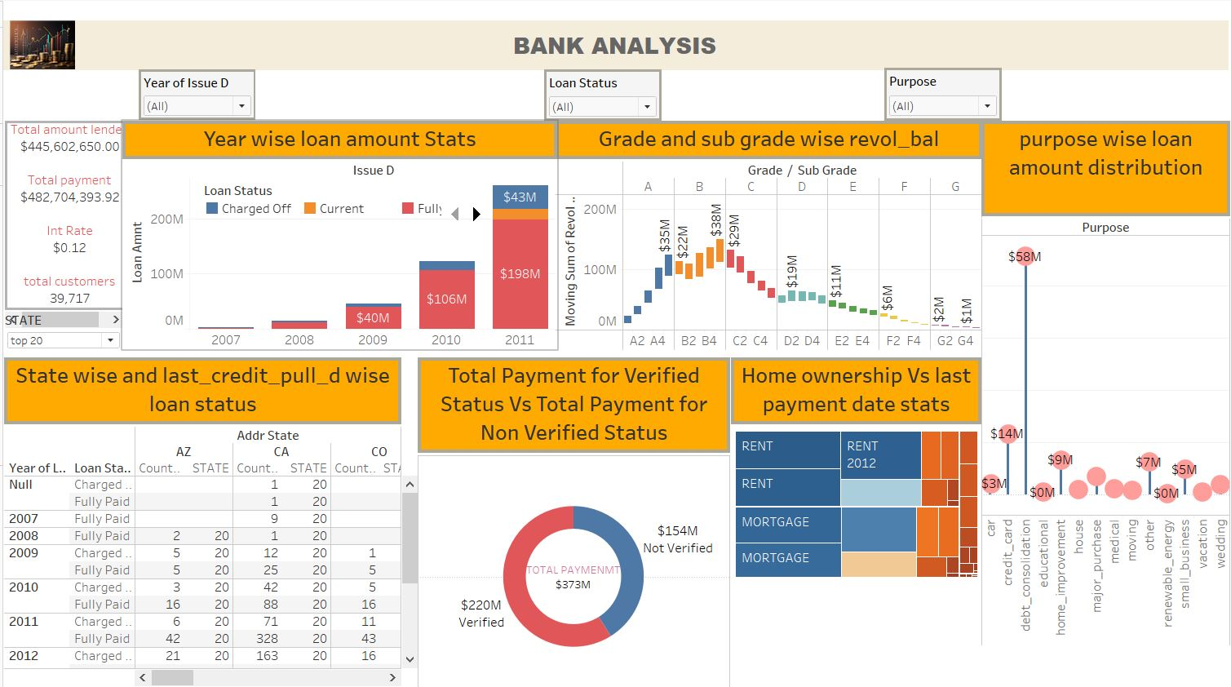
tableau dashnoard

Slide 10
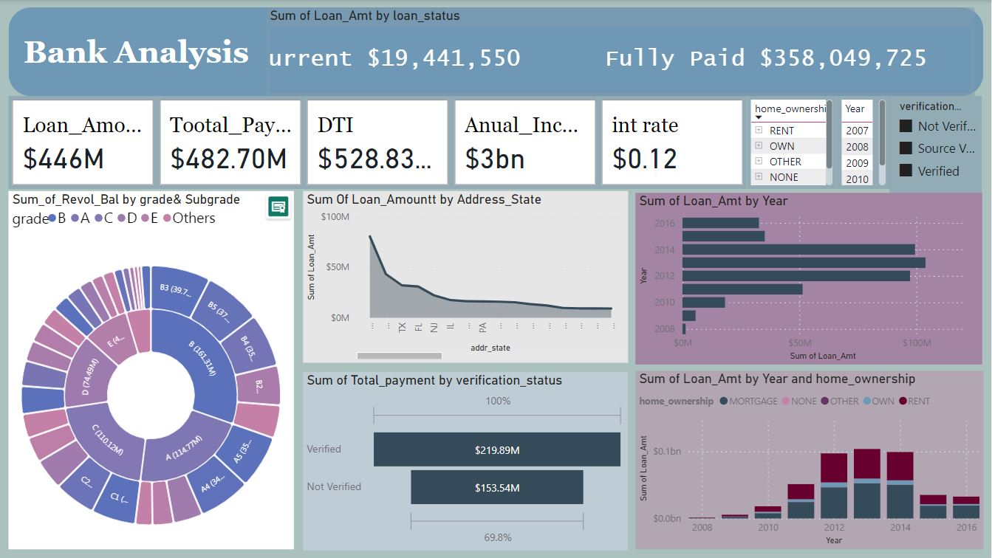
powerbi dashboard

Slide 11
Solutions or suggestions
Perform a detailed risk assessment of these middle-tier categories to ensure that the revolving balances are manageable and do not pose excessive risk.
Enhance the verification process to improve overall payment reliability, possibly increasing the proportion of verified payments.
Investigate the reasons behind the fluctuations in home ownership and consider targeted initiatives or policies to stabilize or encourage home ownership in key years
Focus on understanding the factors driving this growth (e.g., economic conditions, marketing efforts) and consider strategies to sustain or manage this growth effectively.

Slide 12
Thank you

